Slide 1
AWK Commands
-Swetha Muralidharan
20pw35

Slide 2

Regular Expressions
Dot
Start of line
End of line

Slide 3
Regular Expressions
Match – character Set
Exclusive Set
Alteration

Slide 4
Regular Expressions
Zero or One Occurrence
Zero or More Occurrence
One or More Occurrence

Slide 5
Awk Commands – Arrays
Indexes need not to be continuous set of number
either string or number as an array index.
no need to declare the size of an array in advance – arrays can expand/shrink at runtime.
Syntax : array_name[index] = value

Slide 6
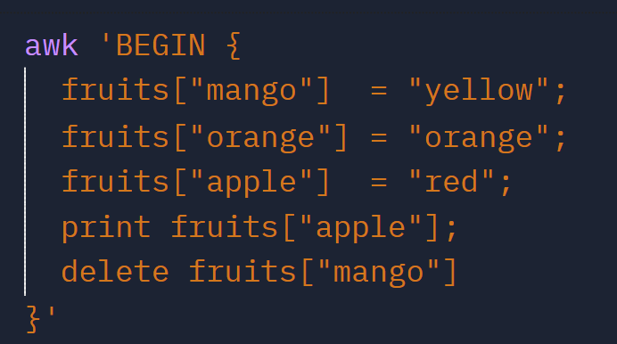

Creating – deleting array

Slide 7

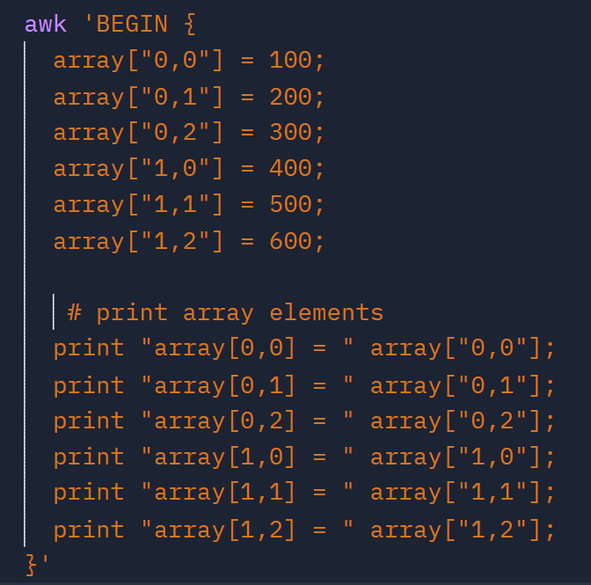
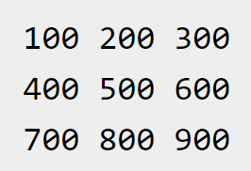
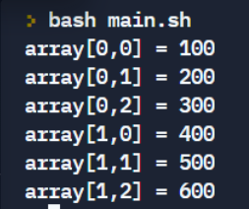
Multi-dimensional array

Slide 8
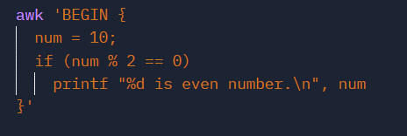
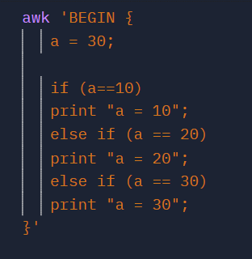
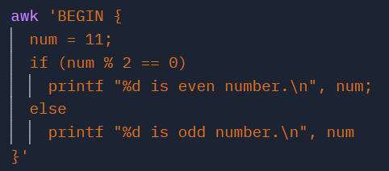
Awk Commands – Control Flow
If statement
If-Else-If statement
If – else statement

Slide 9
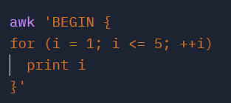
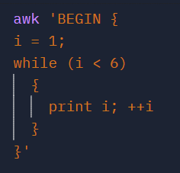
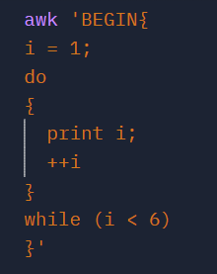
Awk Commands – Loops
For Loop
While Loop
Do - While Loop

Slide 10
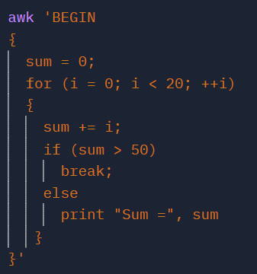
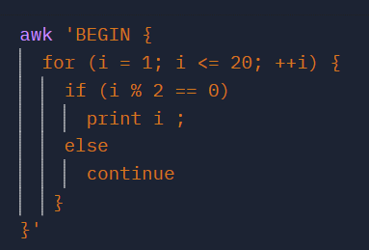
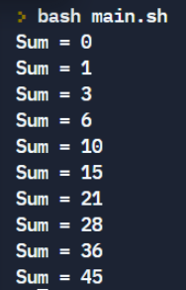
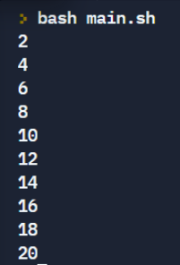
Awk Commands – Loops
Break Statement
Continue Statement

Slide 11
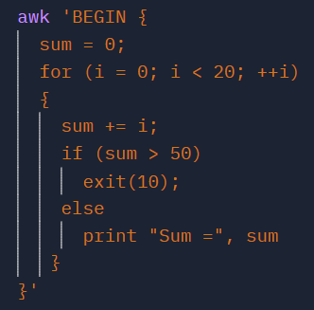
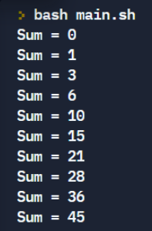
Awk Commands – Loops
Exit Statement

Slide 12
Thank You

